Slide 1
Radiation of the Year
21st Meeting of the European IRPA AS in Liverpool October 2024
A new initiative of the FS

Slide 2
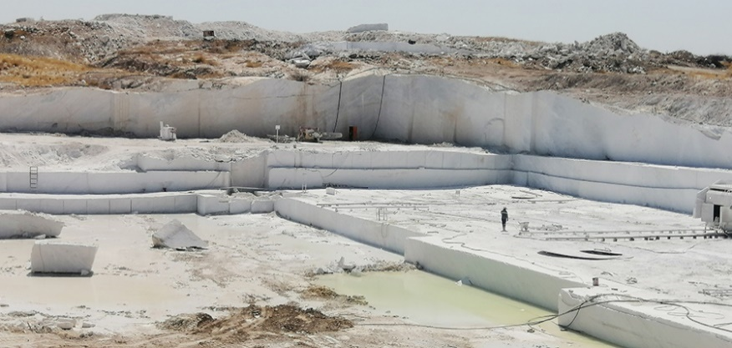
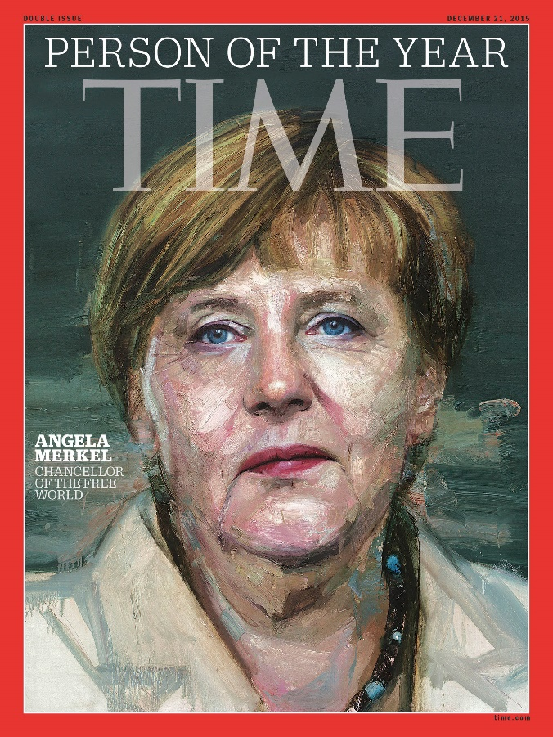
Radiation of the Year
Activities by FS

Slide 3
Radiation of the Year
Aims
Aims
Informing the public about radiation
about facts, history and actual use
about risk and protection
by telling a story about it (discovery, unusual use etc)
to reduce fear of radiation and radiophobia
=> tell the good things about it!

Slide 4
Radiation of the Year
What to do
What to do with a „Radiation of the Year“?
There are several possibilities for activities:
press releases, articles in journals and news papers
releases for public media like tv and social media
internet
presentations on your conferences, webinar
supported by other cooperation partners (medical and technical associations etc)
cooperation with schools
exhibitions
and there are many more

Slide 5
Radiation of the Year
Join our initiative
What to do
First Experiences
Roentgen Radiation (C. W. Röntgen died 100 years ago)
Light Pollution
The Radiation of 2025 is
Gamma Radiation
discovered by
Paul Villard at 1900
125 years ago
contact fs-gf@fs-ev.org

